Slide 1
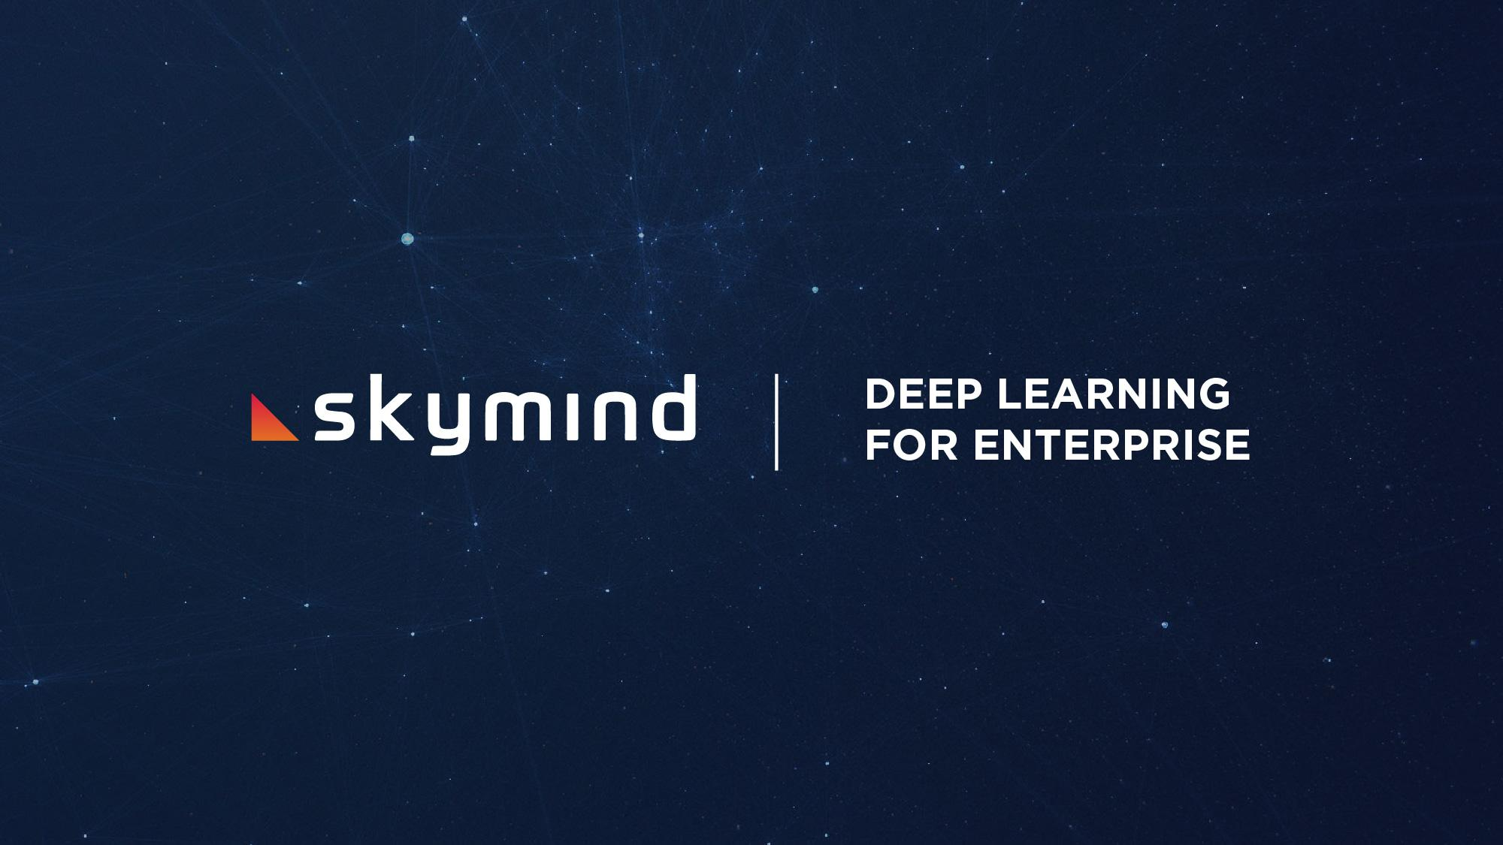

Slide 2

AI WILL IMPACT EVERY INDUSTRY

Slide 3
THE TOP TECH COMPANIES
USE DEEP LEARNING
Google
Facebook
Amazon
Microsoft

Slide 4
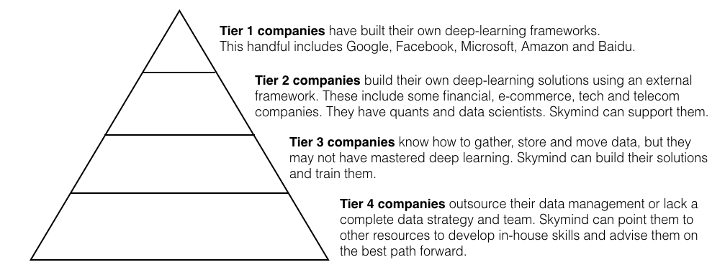
THE REST WILL FOLLOW ... OR DIE

Slide 5
WHAT'S AI?
Algorithms
Notes:
AI is just math and code, and we call that an algorithm.

Slide 6
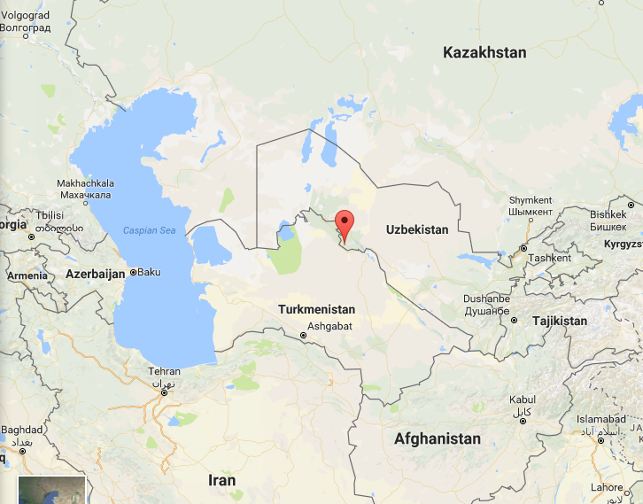
Algorithm: A City in Uzbekistan
Notes:
AI is just algorithms. Algorithm means a method of computation. Here's where it comes from. The etymology of "algorithm": (n.) 1690s, "Arabic system of computation," from French algorithme, refashioned (under mistaken connection with Greek arithmos "number") from Old French algorisme "the Arabic numeral system" (13c.), from Medieval Latin algorismus, a mangled transliteration of Arabic al-Khwarizmi "native of Khwarazm" (modern Khiva in Uzbekistan), surname of the mathematician whose works introduced sophisticated mathematics to the West (see algebra). The earlier form in Middle English was algorism (early 13c.), from Old French. Meaning broadened to any method of computation; from mid-20c. especially with reference to computing.

Slide 7
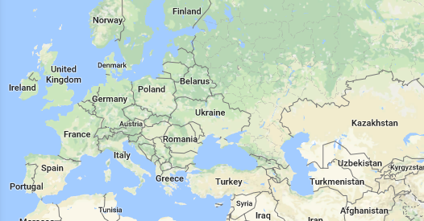
Medieval Movement of Math
Notes:
This is 9th-10th century.

Slide 8
WHAT'S AI?
Algorithms
=
Math & Code
Notes:
A method of computation. A form of mathematical calculation. We run it through a mathematical machine that takes inputs and spits back outputs. We transform inputs, just like a meat grinder or a pasta maker. But here, the input is raw data, and the output is meaning.

Slide 9
WHAT'S AI?
Algorithms
=
Math & Code
DATA
DECISIONS
Notes:
AI makes decisions about data. At the highest level, AI is just math and code that produces decisions when exposed to data.

Slide 10

Human Perception
SENSATION
MEANING
Notes:
Haze of photons, etc.

Slide 11
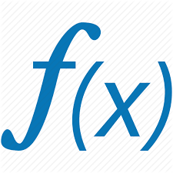
Machine Perception
DATA
DECISIONS
Notes:
Haze of photons, etc.

Slide 12
Prerequisite: Digitization
ANALOG
(REAL LIFE)
NUMBERS BITS 01001101
Notes:
This is where life becomes bits, which are readable by computers. The life around us must be translated to numbers and stored on chips. Massive digitization led to the age of big data. We have stored much more information about the behavior of people and the natural world.

Slide 13
WHAT'S AI?
Algorithms
=
Math & Code
DATA
Images/Video
Sound/Voice
Text
Time Series
DECISIONS
Classification
Name to face
Clustering
Similarity
Predictions
Notes:
AI makes decisions about data. At the highest level, AI is just math and code that produces decisions when exposed to data.

Slide 14

AI vs. ML vs. DL
Notes:
They’re like Russian dolls.

Slide 15
AI vs. ML vs. DL
AI
ML
DL
Notes:
They are subsets of one another.

Slide 16
AI vs. ML vs. DL
Good old-fashioned AI is based on rules (non-ML AI)
Rules tell a computer how to respond to different situations
Called expert systems or rules engines
Static
Machine learning
ML algorithms adapt when exposed to new data
Self-adjusting to improve performance on narrowly defined tasks
Dynamic
Deep learning
Computationally intensive
Superhuman accuracy
State of the art

Slide 17
With AI, it can be hard to explain
the difference between
what’s easy and
what’s virtually impossible.
Notes:
With AI, some things are surprisingly difficult, and others are shockingly easy.

Slide 18
TO BUILD AI
YOU NEED 4 THINGS
Team
Tools
Data
Infrastructure
Notes:
Without them, you can’t build AI. So in a sense, these are the limits of AI. The limits that you may face.

Slide 19
Team
Data Scientists/ML specialists
Analyze data, prototype models
Data Engineers
Gather, move and store data
DevOps
Maintain AI in production

Slide 20
TOOLS
WHAT DOES ENTERPRISE NEED?
Open-source (Linux, Hadoop)
Scalable, Containerized, Fast
Integrates With Existing Tech (JVM)
Cross-Team Solution (DevOps, Data Science)
General-Purpose, Customizable Framework

Slide 21
DATA
Deep learning needs data to train on
That data must match the problem you want to solve
If you lack labeled data (e.g. face, name), a labeled data set can be built
The more, the better
Notes:
Data is to AI what water is to a crop. You can’t grow AI without data, and it needs to be the right kind of data.

Slide 22
INFRASTRUCTURE
AI sits on top of the big data stack
You need software that can gather, move and store data at scale
E.g. Hadoop, Spark, Kafka, Elasticsearch
And you need a hardware cluster for compute (GPUs will speed it up.)

Slide 23
PROBLEMS WE SOLVE

Slide 24
DATA SCIENCE PROBLEMS
Most data science projects fail. Why?
Scarce talent, fragmented efforts
Data scientists fail to share their work
They lack a single source of truth
Wrong tools
Most Python AI tools fail to integrate with big data stack
Researchers choose tools for experiments, not enterprise
Messy data
Companies fail to gather and process data properly
Bad data leads to poor predictions and frustrated end users

Slide 25
TALENT PROBLEM
Talent is a bottleneck in AI and data science.
Companies hire the only talent they can find: AI researchers.
Researchers can’t build AI for enterprise.
And there are not enough of them.

Slide 26
TALENT SOLUTION
The Fortune 2000 is turning their software engineers into AI engineers.
Worldwide: 9-10 million Java developers
6 million software engineers do big data and analytics
Most big data tools are on the JVM
Deep learning only requires undergraduate level math
AI solutions don’t require PhDs. Just engineers to put pieces together.
Skymind gives them corporate training and easy-to-use tools

Slide 27
TOOLING PROBLEM
Deep learning engineers work in Python. Enterprise works in Java.
Researchers won’t change tools, but they need to show value
They need to work with infrastructure to scale, & don’t know how
Blobs of Python and C code are hard to deploy in production.
DevOps teams will kill solutions that destabilize production stack.
We need a cross-team solution!

Slide 28
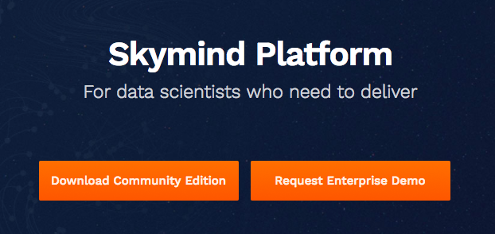
TOOLING SOLUTION
In November 2017, Skymind launched an AI platform that bridges the gap between research and production environments. One-click deployment for trained AI models. The Skymind Intelligence Layer bundles popular Python ML tools like TensorFlow, and operationalizes them.

Slide 29
DATA PROBLEM
Data reflects the real world, and the real world is messy
Many projects fail because of bad data
Companies gathered the wrong data for their problem
They can’t extract signal from noise
Data is incomplete, fields missing
Clients don’t always control the datasets they have
Gathering new data can be expensive
80% of all work on AI solutions is processing data: ETL

Slide 30
DATA SOLUTION
Skymind’s open-source tool DataVec accelerates ETL
Free, open-source library (Trifacta for binary data)
Reusable data pipelines, not one-off, ad hoc code
Scheduled automation of data pre-processing
Skymind’s experienced field team advises clients on
Gathering better data
Cleaning and labeling data
Moving and storing data at scale

Slide 31
INFRASTRUCTURE PROBLEM
Traditional chips like CPUs are not designed for AI workloads
Neural network training can take weeks
Data scientists are valuable, and wasting their time is expensive
GPUs accelerate neural net training, but most organizations don’t know how to plug GPUs into the big data stack

Slide 32
INFRASTRUCTURE SOLUTION
Skymind’s Platform scales on GPUs
Multi-GPU clusters significantly accelerate time to insight
Skymind plugs multi-GPU clusters into Hadoop, Spark, Kafka and other storage and streaming tool efficiently
Skymind gives data scientists a cluster-aware notebook and ML environment that reduces the complexity of their workflow
Skymind’s tools deploy on-prem, in the public cloud, and hybrid

Slide 33
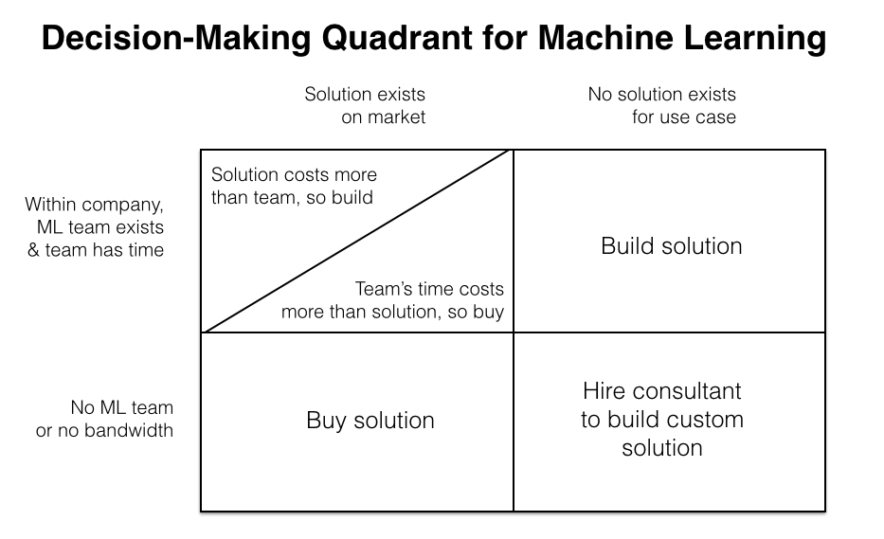

Slide 34
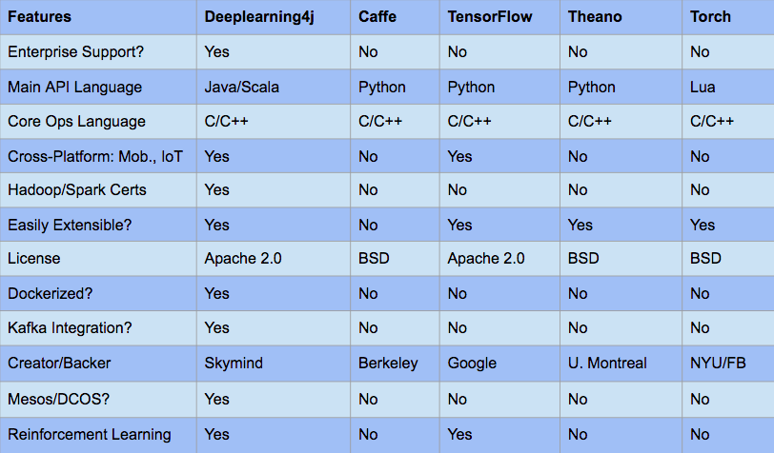
MAJOR DEEP LEARNING LIBRARIES COMPARED
Notes:
All major deep-learning libraries run on multiple GPUs and CPUs. Deeplearning4j is tied with Caffe for speed, and faster than Tensorflow, on multiple GPUs. While Caffe specializes in image processing, it does not include neural nets to process other kinds of data, such as text, time series and sound.

Slide 35
PRODUCT
Notes:
60,000 downloads in November for DL4J. 100,000 for ND4J. 20% mo/mo user growth for Nov.

Slide 36
SKYMIND BUILT
DEEPLEARNING4J
THE MOST WIDELY USED AI FRAMEWORK FOR JAVA
Notes:
60,000 downloads in November for DL4J. 100,000 for ND4J. 20% mo/mo user growth for Nov.

Slide 37
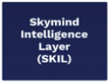
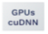

ACCELERATED HARDWARE
PRODUCTION
JVM STACK
+
JAVACPP
SPARK
Existing
Planned
FPGA
ARM
...

Slide 38
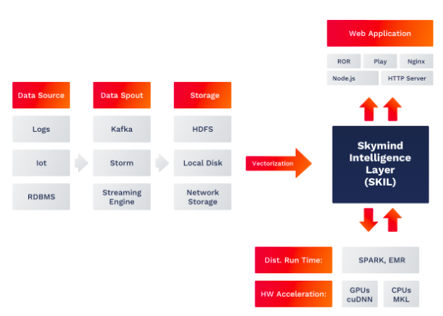
KEY INTEGRATIONS: SPARK, MESOS, KAFKA & HADOOP
Notes:
Spark relies on Hadoop's file system, HDFS.

Slide 39
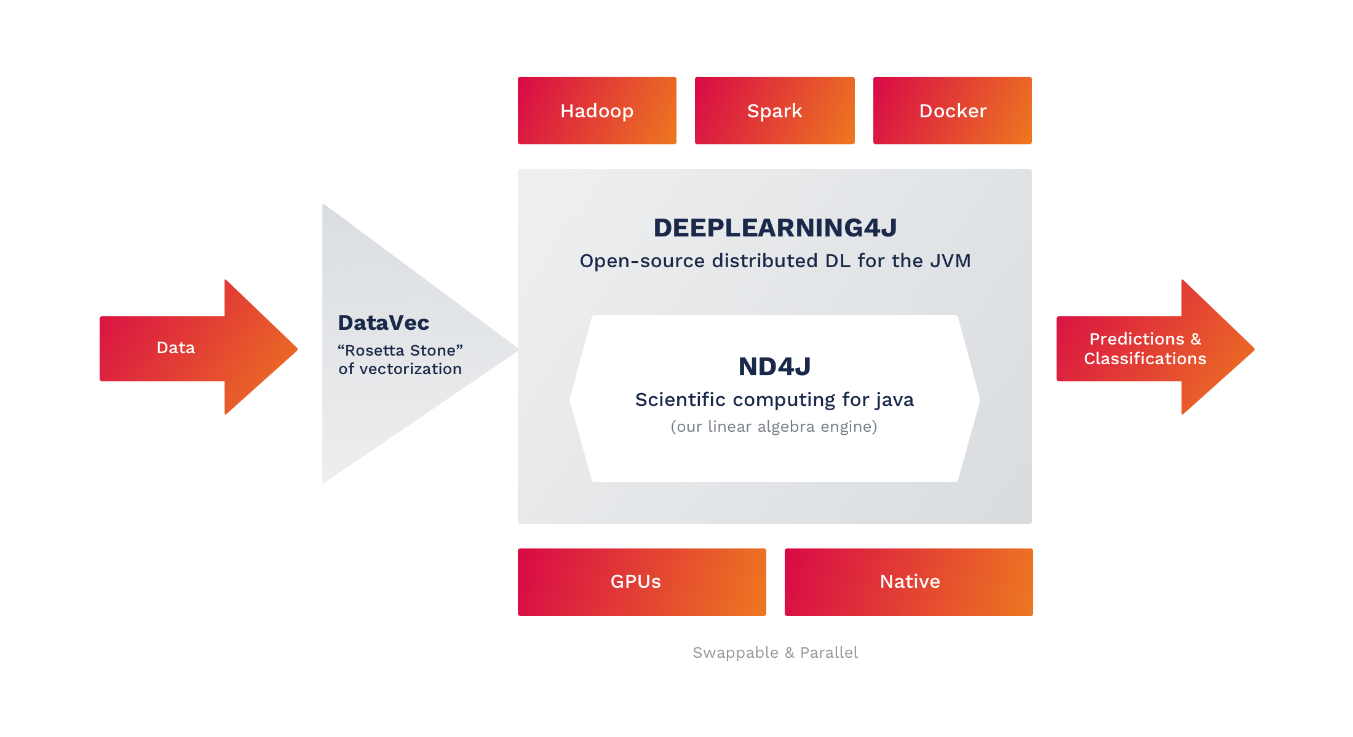
FULL AI STACK: THE SKYMIND INTELLIGENCE LAYER (SKIL)

Slide 40
help@skymind.io

